Slide 1
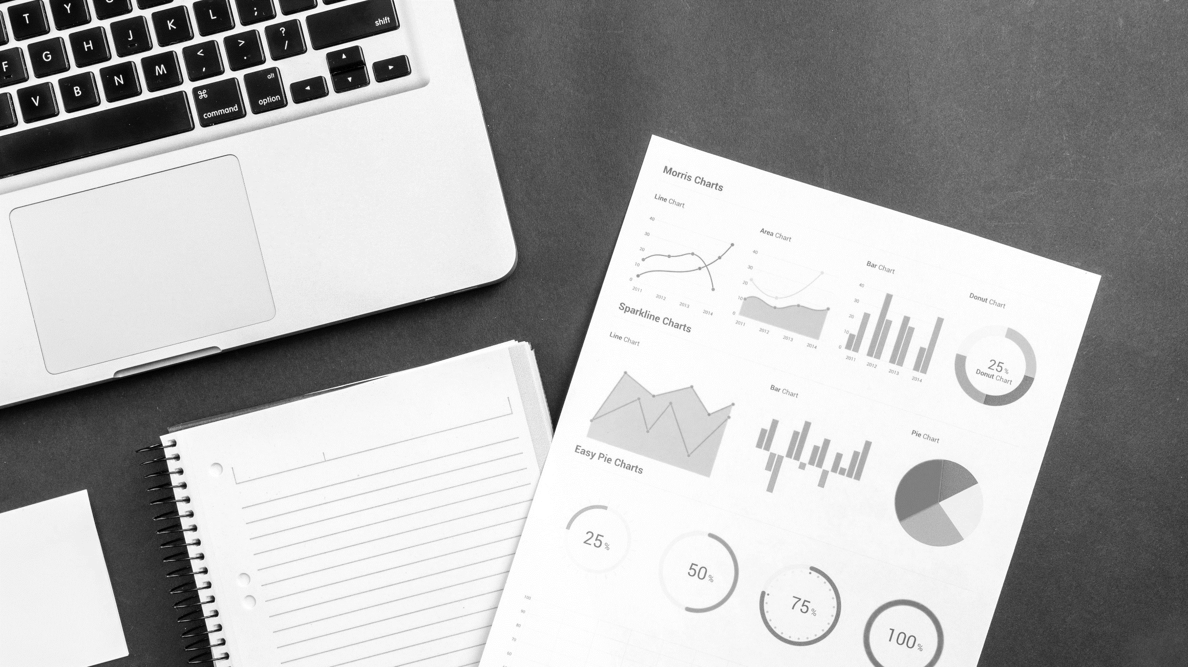



Financial
Risk Analysis
Credit Card Default

Slide 2
THE CREW
ENAVAMSHI GADIKOTA
MOHIT SARDAR
RADHA KRISHNA
ADARSH RAJ
SRUTHI BASANI
Modelling
Tuning
Evaluation
Documentation
Visualization
NAVEEN KONETI
Mentor

Slide 3
A GIST OF DOMAIN
What are Credit Cards?
A credit card are typically issued by banks, and it enables the cardholder to borrow funds from that institution/bank and issuers customarily pre-set borrowing limits, based on an individual's credit rating, they impose the condition that cardholders pay back the borrowed money, plus interest, as well as any additional agreed-upon charges.
What’s in it for banks?
Credit card business is one of the key areas in the banking industry where there exists a huge money flow. Credit card business has been a huge success in the banking market over the years. Most of the banks are also interested in this area expecting a good revenue. Many of the customers use their credit cards beyond their repayment capabilities leading to high debt accumulation and finally defaulting the credits. Classifying the risky and non-risky customers has become a very big challenge for banks.
Problem Statement..!
Identifying the risky and non-risky customers based on the customer characteristics, helping the bank to predict if a customer can repay his credits to the bank in the coming months.

Slide 4
ROADMAP
EXPLORATORY
DATA ANALYSIS
STATISTICAL ANALYSIS
BASELINE MODEL
1
2
3
2
DATA
ENSEMBLES
PERFORMANCE TUNING
5
4
PREDICTIONS
EVALUATION
6
7
BUSINESS SOLUTION

Slide 5
Dataset Description
LIMIT_BAL : Amount of the credit offered per month
SEX : Customer’s Gender (1 = Male, 2 = Female)
EDUCATION : Level of education of the customer (0 , 1 = Graduate School, 2 = University, 3 = High School, 4 = Others, 5 ,6 )
MARRIAGE : Marital status of the customer (0 , 1 = Married, 2 = Single, 3 = Others)
AGE : Customer’s Age
History of past payment (April 2005 to Sept 2005)
Repay : Repayment Status[-2, -1, 0, 1, 2, 3, 4, 5, 6, 7, 8, 9]
Bill_Amt : Amount of bill statement
Pre_Pay : Amount of previous payment
DEFAULT

Slide 6




SWOT ANALYSIS
STRENGTH
WEAKNESS
Can Understand the spending patterns of the customers.
No missing values
No data point can be considered as an outlier in the credit card business
Imbalanced data.
Missing information and explanation about the labels.
Due to the limited information there is a good chance the conclusions do not apply to the entire population.
Use the data to create more new features and predict whether the customer will default the next month.
Study the spending and payment pattern and make relevant recommendation to the business
When a good customer classified as a defaulter it can lead to a bad customer experience (basically wrong conclusions)
Or when a defaulter goes un-identified then it can be a loss to business
OPPORTUNITY
THREATS

Slide 7
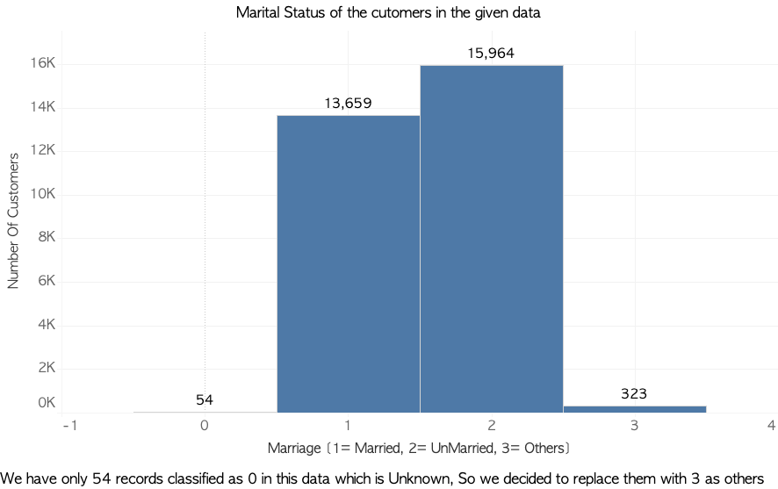
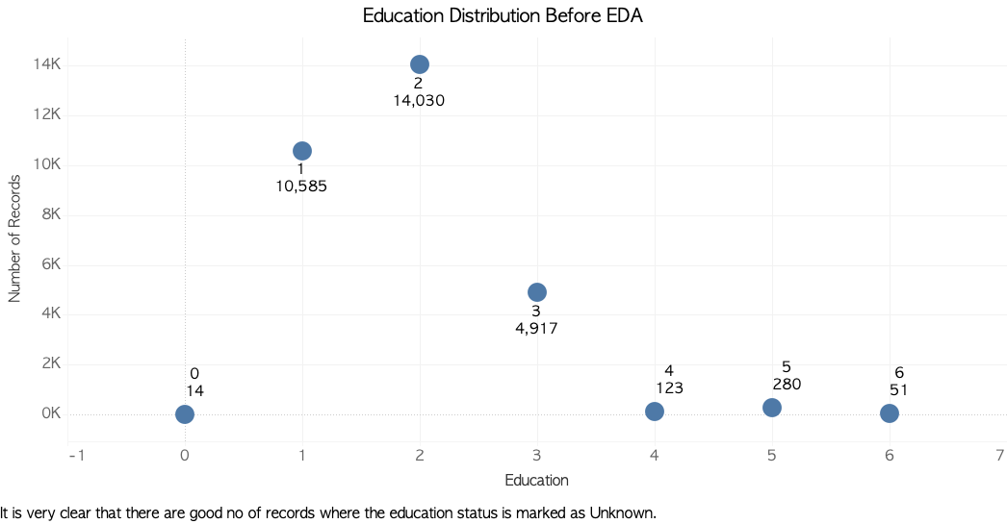
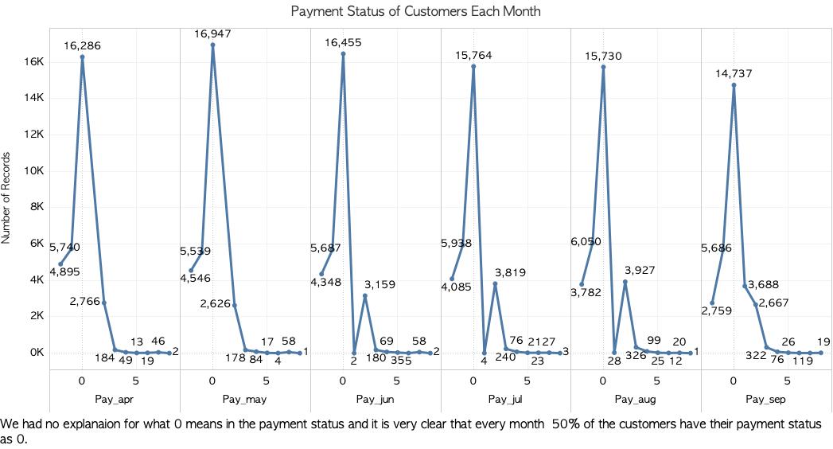
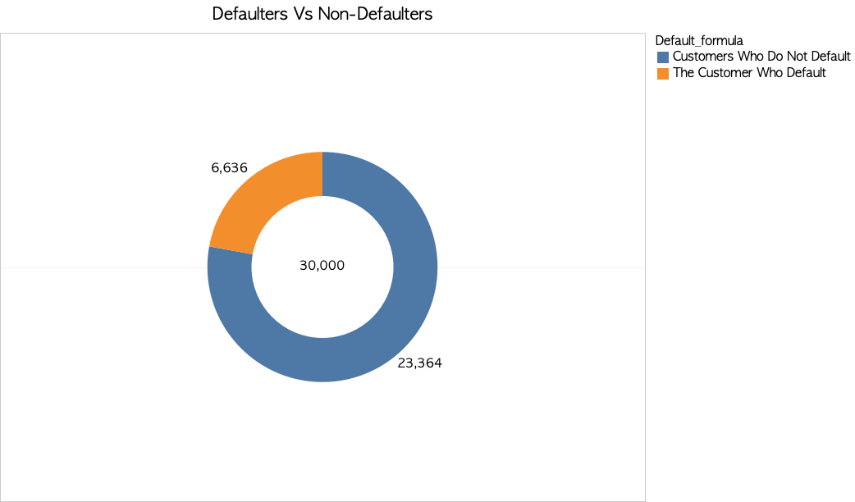
EXPLORATORY DATA ANALYSIS

Slide 8
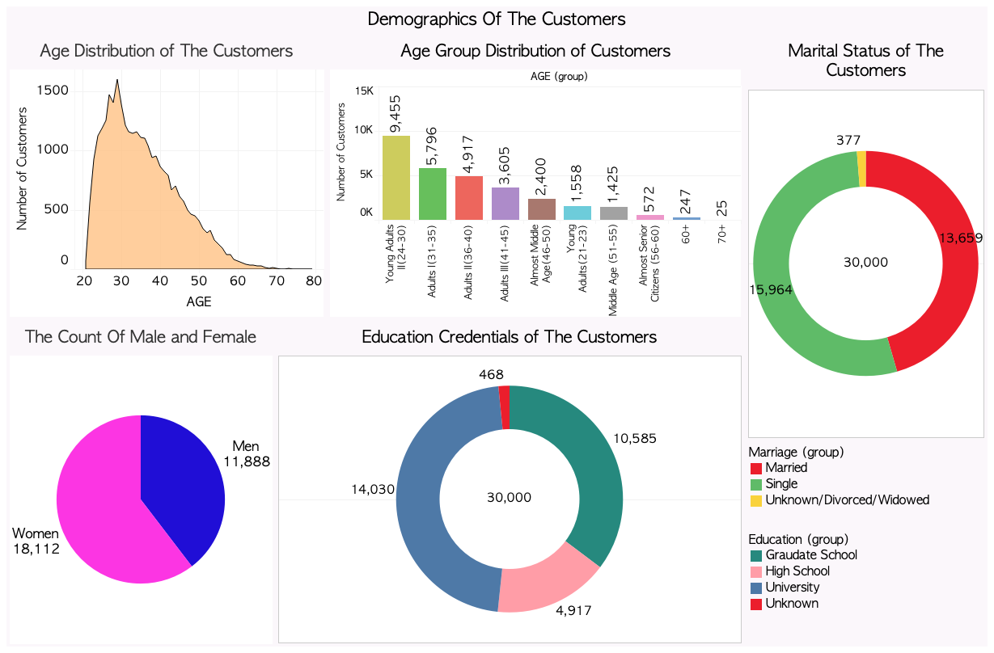

Slide 9
Statistical Analysis

Slide 10

EVALUATION METRICS
Accuracy
Precision
Recall
F1 Score
ROC AUC
Cohen Kappa
Log loss
Due to imbalance in dataset, accuracy alone is not a reliable measure
Our main goal is to identify risky customers (those likely to default) hence Recall is the most important measure
Precision is still important since identifying non-risky customers as risky is bad for business
Hence, F1 Score which is a combination of both precision and recall can be looked at to consider both
ROC AUC tells how much model is capable of distinguishing between classes

Slide 11
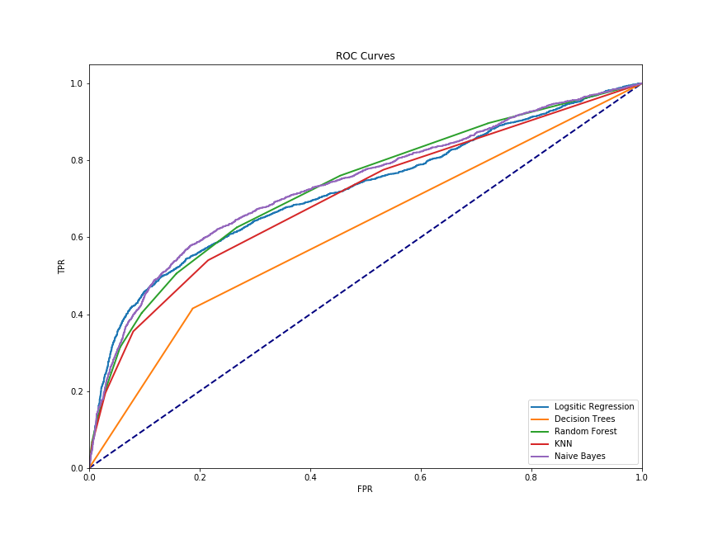
MODEL COMPARISON
METRIC| |MODEL | ACCURACY | PRECISION | RECALL | F1SCORE
LOGISTIC REGRESSION | 0.81 | 0.71 | 0.23 | 0.35
KNN | 0.79 | 0.56 | 0.36 | 0.43
NAIVE BAYES | 0.75 | 0.45 | 0.60 | 0.51
DECISION TREES | 0.72 | 0.38 | 0.42 | 0.40
RANDOM FOREST | 0.81 | 0.62 | 0.31 | 0.42

Slide 12
COMING PROGRESSION
BALANCING
MODEL BUILDING
UNDER SAMPLING, OVER SAMPLING
CREATING COMPONENTS
CROSS VALIDATIONS
PCA
FEATURE ENGINEERING
ENSEMBLING
CREATING FEATURES
BOOSTING, BAGGING

Slide 13

LET’S CLARIFY
THANK YOU

